Slide 1
How to Link a Set of Records to the Network Zone Institution
in batch
Yoel Kortick
Senior Librarian

Slide 2
Agenda
Introduction
The job Link a Set of Records to the Network Zone
A live demo using "Contribute IZ records"
A live demo not using "Contribute IZ records"
2

Slide 3
Introduction

Slide 4
Introduction
This presentation will focus specifically on linking a set of records to the Network Zone institution in batch mode.
For full details on manually linking individual records to the Network Zone manually see
  Separate presentation How to Control Where to Save New Records Templates and Rules From a Member Institution of a Network Zone Consortia.pptx
  Separate presentation Alma Collaborative Network and Shared Catalog for Network Zone Consortia.pptx section “Linking a record from the Member Institution to the Network Zone”
  Online help Copying and/or Linking Local and Network Zone Bibliographic Records
  Online help Selecting Where to Create New Bibliographic Records

Slide 5
The job Link a Set of Records to the Network Zone

Slide 6
The job Link a Set of Records to the Network Zone
The job Link a Set of Records to the Network Zone allows the institution to link existing local records to Network Zone records in bulk.
  This job appears only for Member Institutions of a Network Zone Consortia
  This job will not appear for Standalone institutions or for Network Zone institutions, as it is irrelevant for these types of institutions
This job works on sets of content type “Bibliographic Title”. This includes
  All Titles
  Physical Titles
  Electronic Titles
  Digital Titles

Slide 7
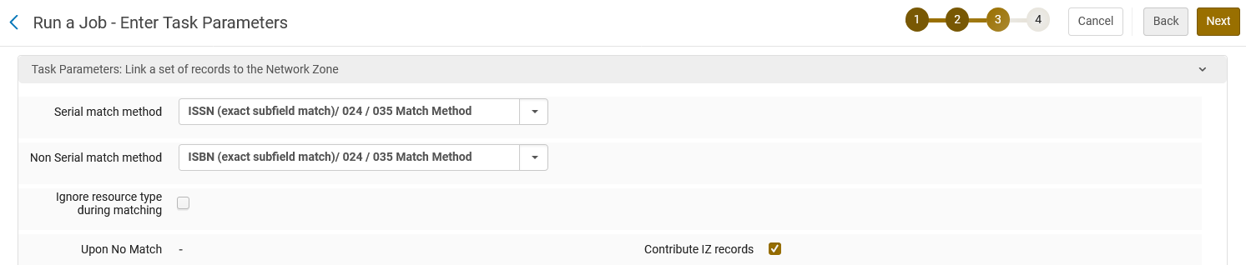
The job Link a Set of Records to the Network Zone
The parameters in the job which we will focus on are
  Serial match method
  Non Serial match method
  Contribute IZ records (checkbox for yes or no)

Slide 8
The job Link a Set of Records to the Network Zone
Match Methods
  The options available to choose for the parameters “Serial match method” and “Non Serial match method” are the same as other places in Alma where match methods are chosen (for example in the import profile).
  For a list of the possible match methods see:
    The matching parameters and options at Link a Set of Records to the Network Zone which appears on the Manual Jobs page.
  For a list and an explanation of each match method see:
    Match Methods – Explanations and Examples which appears on the Managing Import Profiles page

Slide 9
The job Link a Set of Records to the Network Zone
Contribute IZ records
  When this parameter not checked only matching records will be contributed to the Network Zone
  When checked both matching records and nonmatching records will be contributed to the Network Zone
  This will become clearer during the live demo.
    We will run the job once while checking “Contribute IZ records” and once without checking “Contribute IZ records”

Slide 10
The job Link a Set of Records to the Network Zone
We will now look at two live examples with a variety of records in a set.
Looking at live examples will be a useful way to see how the job works.
In the first example we will check “Contribute IZ Records” when running the job.
In the second example we will not check “Contribute IZ Records” when running the job.

Slide 11
A live demo using "Contribute IZ records"

Slide 12
A live demo using "Contribute IZ records"
In member institution “Open University” we have a set called “Records to link to NZ 202408021337”
It has three records, all of which are currently not linked to the Network Zone:
  MMSID 9918010000193. Title “Teen Vogue”. ISSN 1540-2215. In member institution “Open University” it has physical inventory. This record is in the Network Zone with the same ISSN and in the Network Zone it is linked to Community Zone and has no “Held By” or “Available For”
  MMSID 9925509900193. Title “Women”. ISBN 0847807843. In member institution “Open University” it has physical inventory. This record is in the Network Zone and in the Network Zone with the same ISBN it is “Held By” University of Knowledge”.
  MMSID 9925509800193. Title ”Addressing risks in promoting financial stability”. ISBN 9789839478044. In member institution “Open University” it has physical inventory. This record is not in the Network Zone.

Slide 13
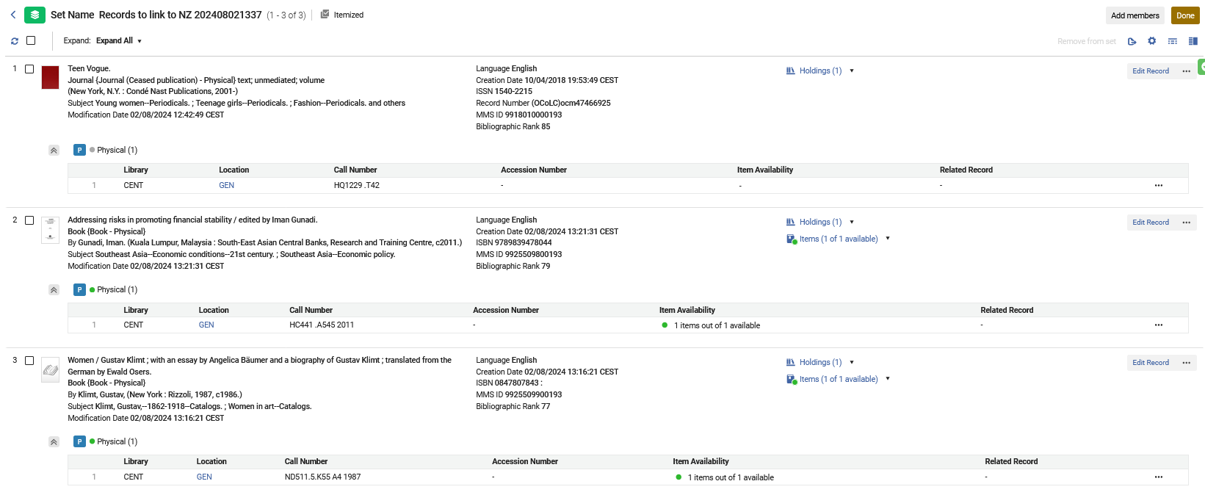
A live demo using "Contribute IZ records"
Here is the set
Note that none of these records have an icon showing a link to the Network Zone

Slide 14
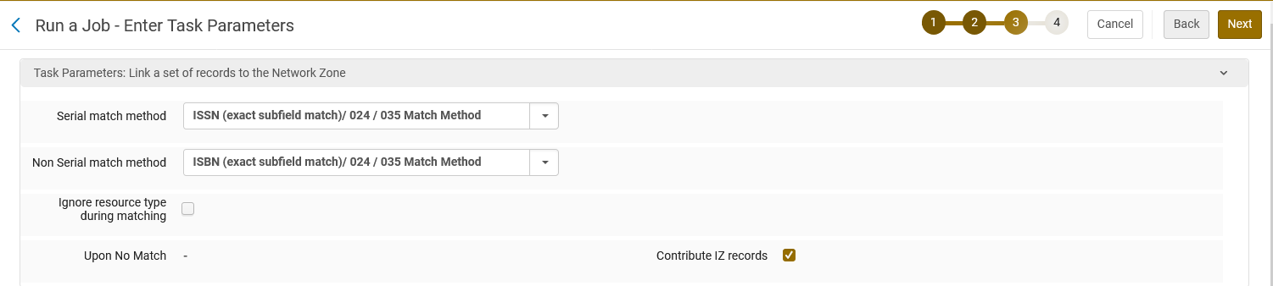
A live demo using "Contribute IZ records"
Here we run the job “Link a set of records to the Network Zone”.
Matching by ISSN and ISBN
“Contribute IZ Records” is checked

Slide 15
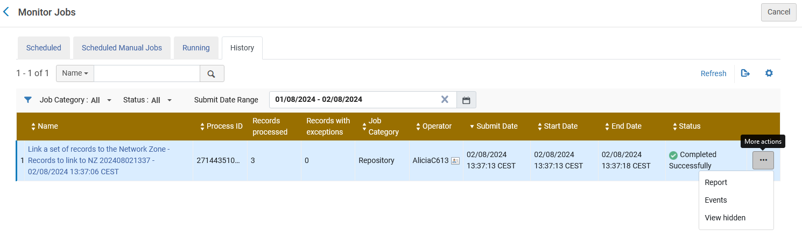
A live demo using "Contribute IZ records"
The job completes and we view the report.

Slide 16
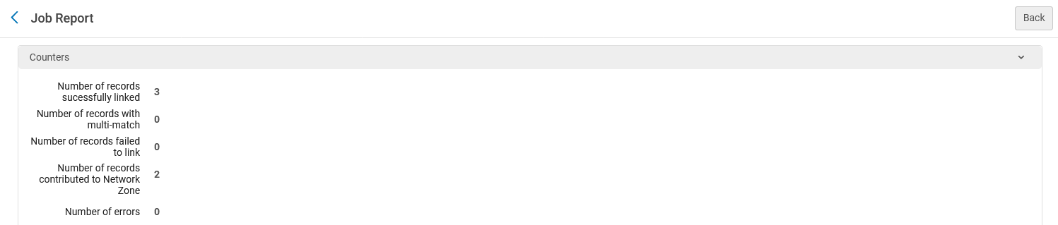
A live demo using "Contribute IZ records"
Three records were linked to the Community Zone.
Two records were contributed to the Network Zone

Slide 17
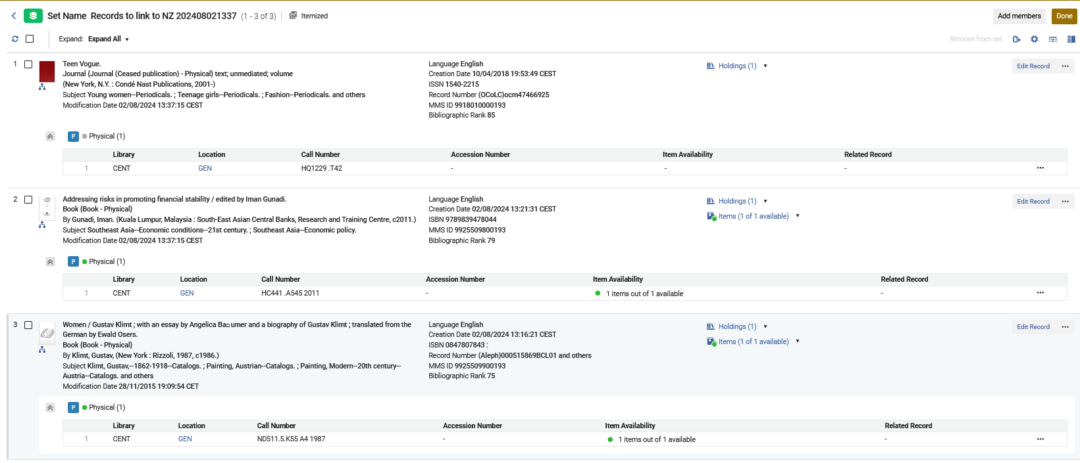
A live demo using "Contribute IZ records"
Here is the set now.
Note that all of these records have an icon showing a link to the Network Zone.
This is because of the job “Link a set of records to the Network Zone)”
The record which was not in the network zone (MMSID 9925509800193) was contributed to the Network Zone

Slide 18
A live demo using "Contribute IZ records"
On the next slide we will see why the job report stated the following:
  Three records were linked to the Community Zone.
  Two records were contributed to the Network Zone

Slide 19
A live demo using "Contribute IZ records"
ISSN 1540-2215 (Title “Teen Vogue”) was formerly in the Network Zone and linked to Community Zone with no “Held By” or “Available For”. Now it is in the Network Zone with a new bibliographic record (not the existing one which was linked to the Community Zone) and is “Held By” Open University. This was contributed to the Network Zone because we checked “Contribute IZ records”.
ISBN 0847807843 (Title “Women”) was formerly in the Network Zone and “Held By” University of Knowledge. Now it is also “Held By” Open University.
ISBN 9789839478044 (Title ” Addressing risks in promoting financial stability”) was formerly not in the Network Zone. Now it is in the Network Zone and is “Held By” Open University. This was contributed to the Network Zone because we checked “Contribute IZ records”..

Slide 20
A live demo not using "Contribute IZ records"

Slide 21
A live demo not using "Contribute IZ records"
In member institution “Open University” we have a set called “Records to link to NZ 202408021503”
It has three records, all of which are currently not linked to the Network Zone:
  MMSID 9925509700193. Title “Taipei People Pai Hsien-Yung”. ISBN 988-237-706-8. In member institution “Open University” it has physical inventory. This record is in the Network Zone with the same ISBN and in the Network Zone it is linked to Community Zone and has no “Held By” or “Available For”
  MMSID 9925209800193. Title “Travel guide Taiwan”. ISBN 9781837582488. In member institution “Open University” it has physical inventory. This record is in the Network Zone and in the Network Zone with the same ISBN it is “Held By” University of Knowledge”.
  MMSID 9925509600193. Title ” Beechwood Cemetery”. ISBN 1551167352. In member institution “Open University” it has physical inventory. This record is not in the Network Zone.

Slide 22
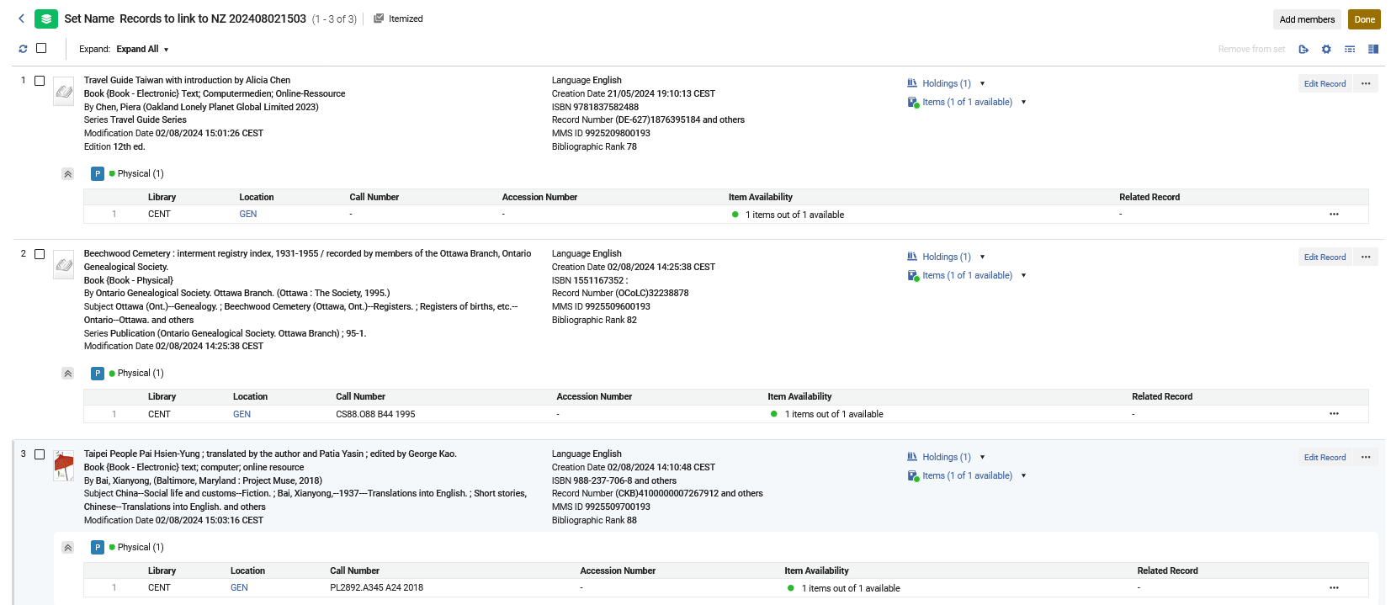
A live demo not using "Contribute IZ records"
Here is the set
Note that none of these records have an icon showing a link to the Network Zone

Slide 23
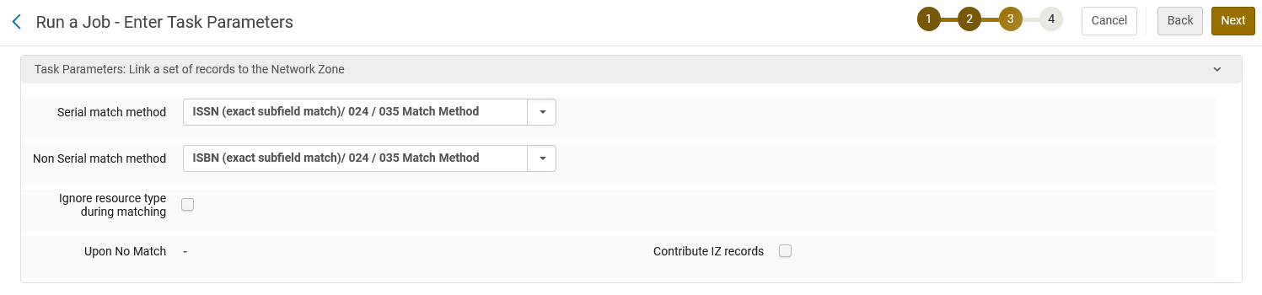
A live demo not using "Contribute IZ records"
Here we run the job “Link a set of records to the Network Zone”.
Matching by ISSN and ISBN
“Contribute IZ Records” is not checked

Slide 24
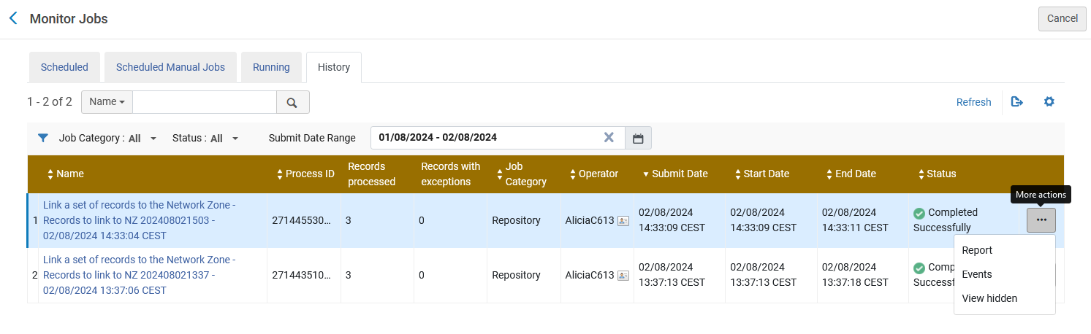
A live demo not using "Contribute IZ records"
The job completes and we view the report.

Slide 25
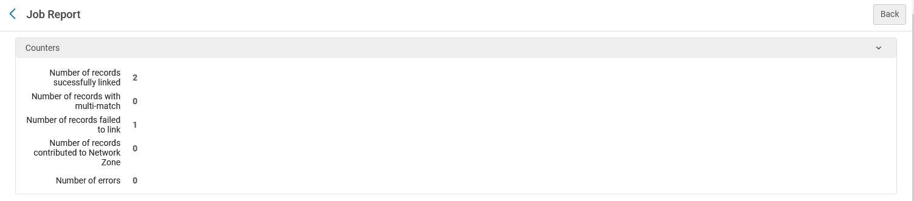
A live demo not using "Contribute IZ records"
Two records were linked to the Community Zone.
No records were contributed to the Network Zone. This is logical because this time we did not check “Contribute IZ records”.
1 record failed to link

Slide 26
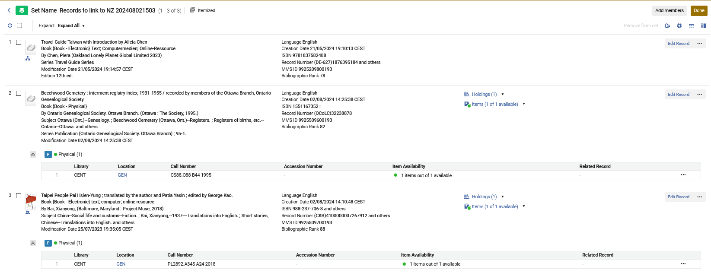
A live demo not using "Contribute IZ records"
Here is the set now.

Slide 27
A live demo not using "Contribute IZ records"
On the next slide we will see why the job report stated the following:
  Two records were linked to the Community Zone.
  No records were contributed to the Network Zone. This is logical because this time we did not check “Contribute IZ records”.
  1 record failed to link

Slide 28
A live demo not using "Contribute IZ records"
  MMSID 9925509700193. Title “Taipei People Pai Hsien-Yung”. ISBN 988-237-706-8. In member institution “Open University” it has physical inventory. This record was in the Network Zone with the same ISBN and in the Network Zone it was linked to Community Zone and has no “Held By” or “Available For”. The job did not contribute a new record (because we did not check “Contribute IZ records”). Instead, it linked this record to the Community Zone record. In the Network Zone it now shows ‘Held By Open University”
  MMSID 9925209800193. Title “Travel guide Taiwan”. ISBN 9781837582488. In member institution “Open University” it has physical inventory. This record is in the Network Zone and in the Network Zone with the same ISBN it is “Held By” University of Knowledge”. This was linked to the Network Zone. It the Network Zone it now shows ‘Held By Open University” and “Open University”
  MMSID 9925509600193. Title ” Beechwood Cemetery”. ISBN 1551167352. In member institution “Open University” it has physical inventory. This record is not in the Network Zone. This record “Failed to link”. It did not already exist in the Network Zone so it had nothing to link to and was not contributed (because we did not check “Contribute IZ records”). .

Slide 29
Thank You

